Slide 1
Spatial Acoustic Analysis
Ryan Adolph, Michael Oswald, MJ Parker
Dr Clem Izurieta

Slide 2
Abstract
Spatial awareness and signal profiling are important in defense and civilian settings.
The project designs a modular, real-time audio sensing system on a Raspberry Pi.
The system captures audio, decomposes channels, beamforms, and runs FFT analysis.
Outputs are stored and transferred to an operator PC for comparison and display.
Goal: lightweight, extensible sensing in resource-constrained environments.

Slide 3
Introduction
Objective: build a functional signal intelligence system.
The system combines acoustic observation and RF spectrum awareness.
It aims to detect, identify, and characterize signal-emitting systems.
The design emphasizes accessible parts and a simple interface.
It reduces complex input into actionable intelligence packets.

Slide 4
Background
Modern environments contain many acoustic and electromagnetic emissions.
These signals can help characterize transportation, communication, ECM, and drones.
Cost, deployability, and stability matter for real-world use.
The team’s goal is to build a system that is practical and affordable.

Slide 5
Tools
Raspberry Pi 4 Model B.
Audio Interface (Mixpre 6 II).
Microphones, 4x Shure Beta 98.
Connecting cables.
Operator PC.

Slide 6
Background: Similar Projects
FPGA Implementation of a Bartlett Direction of Arrival algorithm for a 5.8GHz Circular Antenna Array, 2016
This paper outlines an FPGA implementation of a Direction of Arrival algorithm using an array of Antennas
This research was done locally by the Montana State Electrical and Computer Engineering Department by Brock J. LaMeres, Yikun Huang, Monther Abusultan, Sam Harkness
Developing A Real-Time SDR System, Implementing software-defined radio by integrating a tool like GNU Radio with real FPGA hardware and design and verification tools. July 29th, 2021
This paper outlines how a Software-Defined Radio System (SDR) is implemented on a FPGA board.
The main goal of an SDR is to transfer audio data through analog channels, breaking down the incoming wave signal into digital signals.

Slide 7
Background: The Difference
Our project is designed for everyday users to buy, set up, and upgrade.
The Bartlett DOA project uses an FPGA and antenna array, which is faster and more specialized.
Our system uses 4 microphones, an audio mixer, and a Raspberry Pi.
The project avoids extra SDR complexity by using the mixer’s built-in conversion to digital audio.
The Raspberry Pi analyzes the resulting .wav data with FFT.

Slide 8
Work Schedule: Responsibilities
Whole Group:
Personal Resumes
Poster Completion
Portfolio Completion
Research Celebration Presentation (5/1/26)
Final Capstone Presentation (5/5/26)

Slide 9
Work Schedule: Milestones
Implement FFT with microphones.
Create microphone stand.
Update FFT code for beamforming.
Start UI design.
Create beamforming algorithm.
Build Raspberry Pi to operator PC pipeline.
Update UI.
Finish prototype testing.
Present at Student Research Celebration.
Finalize portfolio.

Slide 10
Lifecycle Approach
The system can grow with more microphones and stronger computation.
It could be expanded for military vehicle defense or home intrusion detection.
The design emphasizes low cost, fast information gathering, and simplicity.
It is intended to be usable by non-technical people.

Slide 11
Functional/Nonfunctional Requirements
Functional:
Detect a signal being emitted
Profile a signal being detected
Match audio signal to RF signal
Consistently tracks object location and behavior
Create and log a database of object profiles for identification and comparison
Non-Functional Requirements:
Minimized the overhead of code/hardware needs
Avoid displaying noise in the final User Interface presentation
Display simple User Interface
System setup can be done by non-technical personnel / is simple

Slide 12
Interface Requirements
Must display each microphones output
Must use a layout that is easy to read and navigate
Must allow the user to view microphone output without additional configuration
Shall display a scrollable system log containing recent events and errors
Shall include a timestamp for every entry within the system log
Shall display radar-detected targets in a real-time

Slide 13
Development Standards, Tools Used, etc.
The project follows the Factory design pattern for modularity.
Open-source FFT code was adapted instead of written from scratch.
The audio mixer handles noise filtering before data reaches the Pi.
The design supports future upgrades and easier maintenance.

Slide 14
Methodology
A 4-microphone array captures audio in 0.25-second intervals every 0.50 seconds.
The combined .wav file is split into 4 channels.
Beamforming determines the direction of the incoming signal.
FFT analysis extracts frequency information from each channel.
FFT output is stored and transferred to the operator PC.

Slide 15
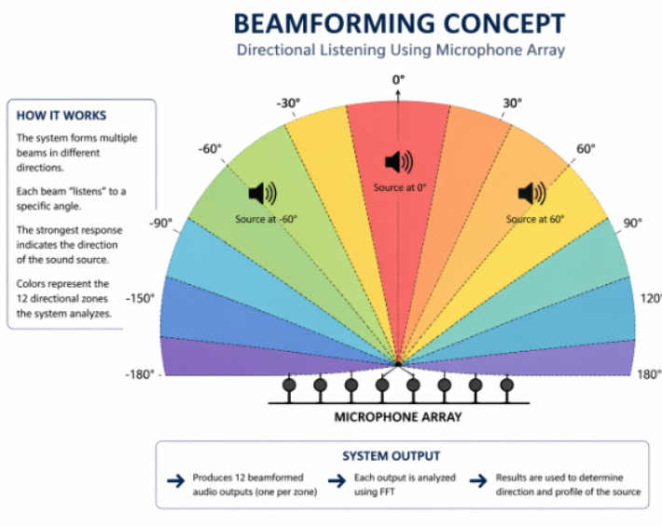

Slide 16
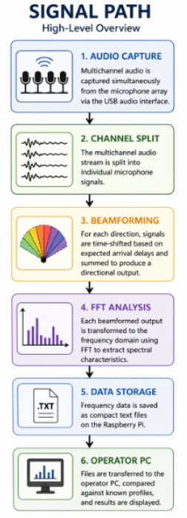

Slide 17
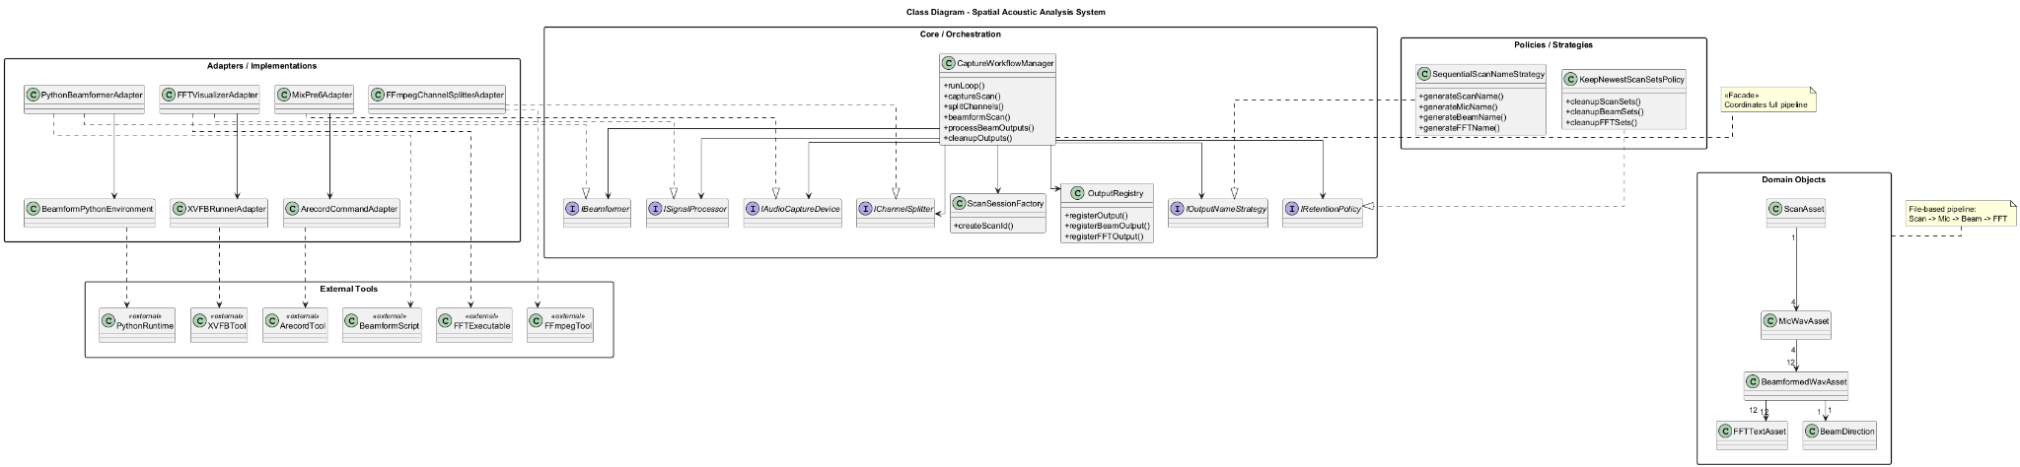

Slide 18
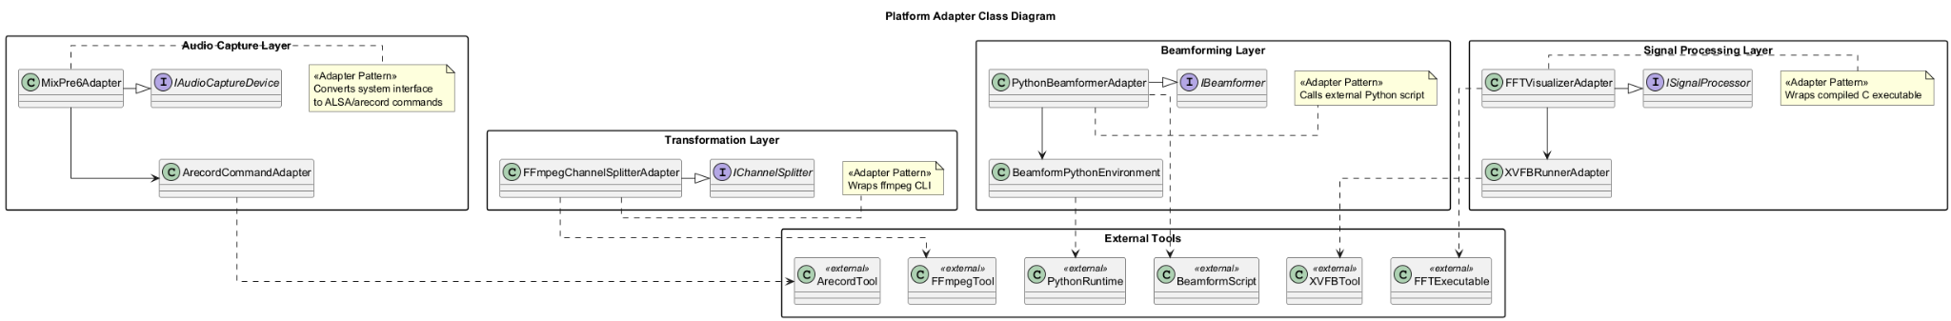

Slide 19
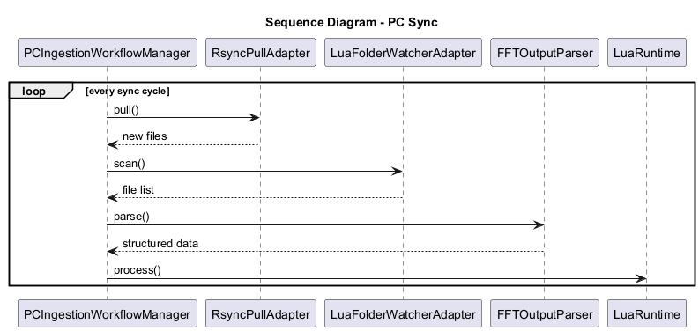

Slide 20
Design Patterns: Pipeline
Audio capture, channel decomposition, beamforming, and frequency analysis form a pipeline.
The pipeline separates each processing stage.
File-based interfaces support interoperability across tools and languages.
Example flow: Scan.wav → Mic_*.wav → Beam_Angle_*.wav → FFT_Output.txt.

Slide 21
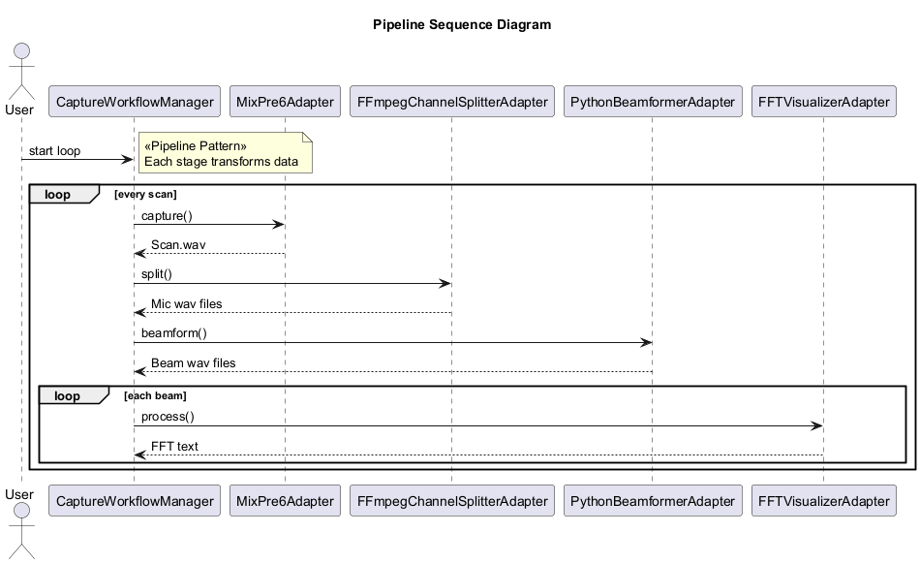

Slide 22
Design Patterns: Facade
The shell script acts as a single entry point for the full system.
It coordinates capture, splitting, beamforming, FFT, output management, and cleanup.
This simplifies user interaction.
It hides the complexity of the subsystem.

Slide 23
Design Patterns: Strategy
Naming rules and retention policies are separated from core processing.
Sequential scan naming keeps outputs traceable.
Retention logic controls storage growth.
These policies can change without rewriting the processing pipeline.

Slide 24
Design Patterns: Producer–Consumer
The Raspberry Pi produces FFT output files.
The operator workstation consumes them for analysis and visualization.
rsync is used for file transfer.
This decouples real-time processing from deeper analysis.

Slide 25
Design Patterns: Layered Architecture
The system has layers for audio capture, signal transformation, spatial processing, frequency analysis, and external processing.
Each layer uses defined interfaces.
Improvements can be made in one layer without breaking others.
This complements the pipeline structure.

Slide 26
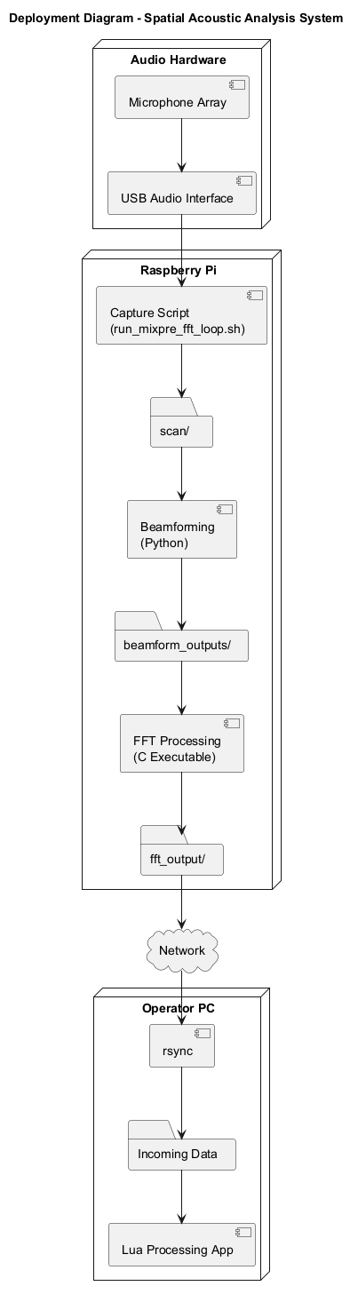

Slide 27
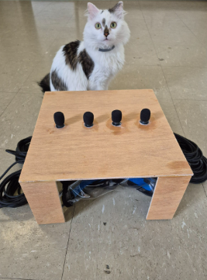

Slide 28
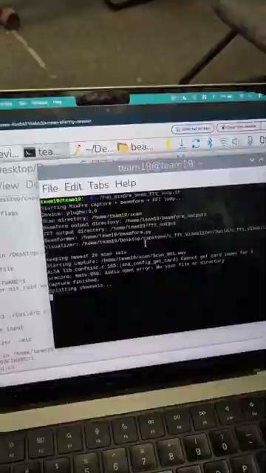

Slide 29


Slide 30
Opportunities for Expansion
Expand to a larger microphone array
Move demanding processing to FPGA or stronger hardware.
Add RF antenna input for trigger-based sensing.
Support wider defense and monitoring applications.
Database expansion to document and track historical data
Better anomaly interpolation

Slide 31
Conclusion
Small, affordable components can support basic detection and alarm systems.
The project demonstrates that drone-defense-style sensing can be accessible.
The system reduces the need for advanced coding or math once prepared properly.

